Slide 1
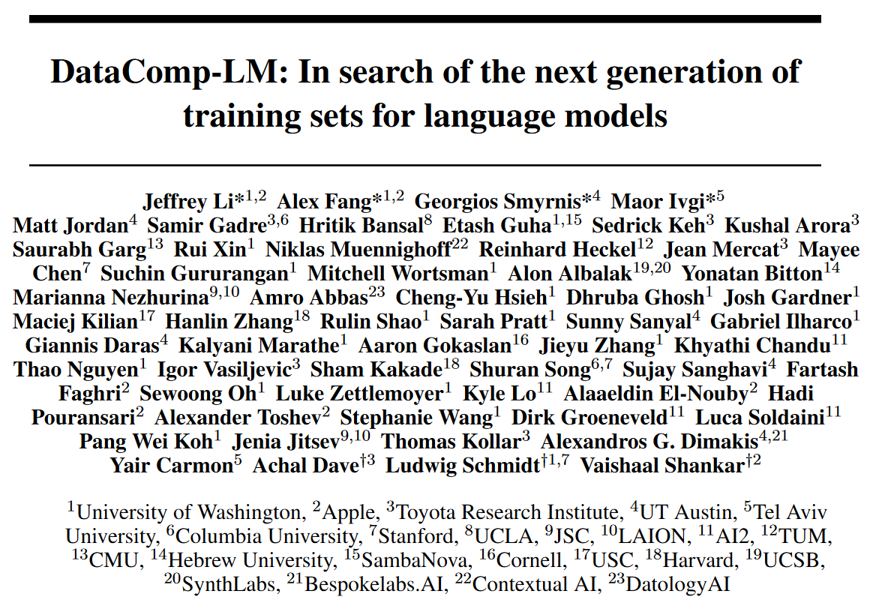
arXiv 2406.11794

Slide 2
Abstract
DataComp for Language Models A testbed for controlled dataset experiments for language models.
Corpus: 240T tokens extracted from Common Crawl.
Effective pretraining recipes based on OpenLM.
Test suite of 53 downstream evaluation.
DCLM-baseline: A baseline for DCLM, using model-based filtering.
7B model with 64% 5-shot accuracy on MMLU with 2.6T training tokens. Comparable to Mistral-7B-v0.3 and Llama 3 8B on MMLU (63% and 66%). 6.6× less compute in training than Llama 3 8B.
The benchmark, framework, models and datasets are all open-sourced.

Slide 3
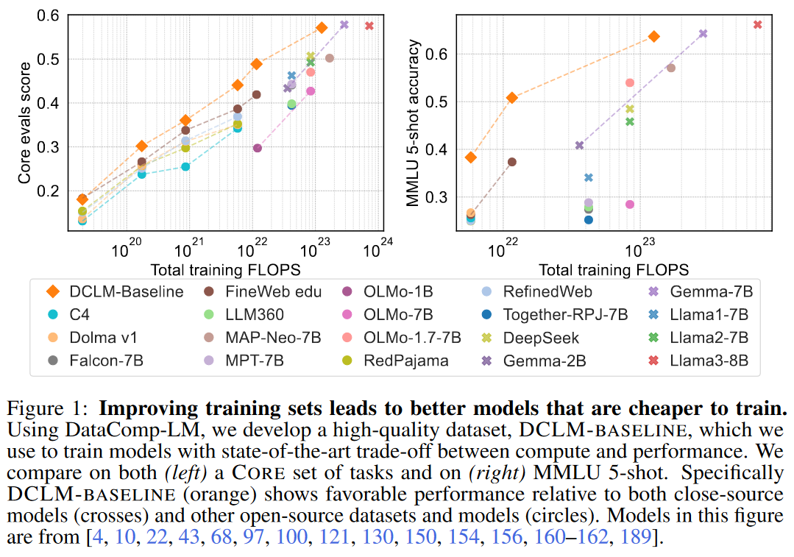
Improving training sets leads to better models that are cheaper to train

Slide 4
Motivation
Task of the benchmark: training dataset curation.
Why datasets in previous work are not good enough?
Not controlled comparisons: they often use different architectures, compute or hyperparameters.
Closed training sets: often the weights are available, but the training sets are not.

Slide 5
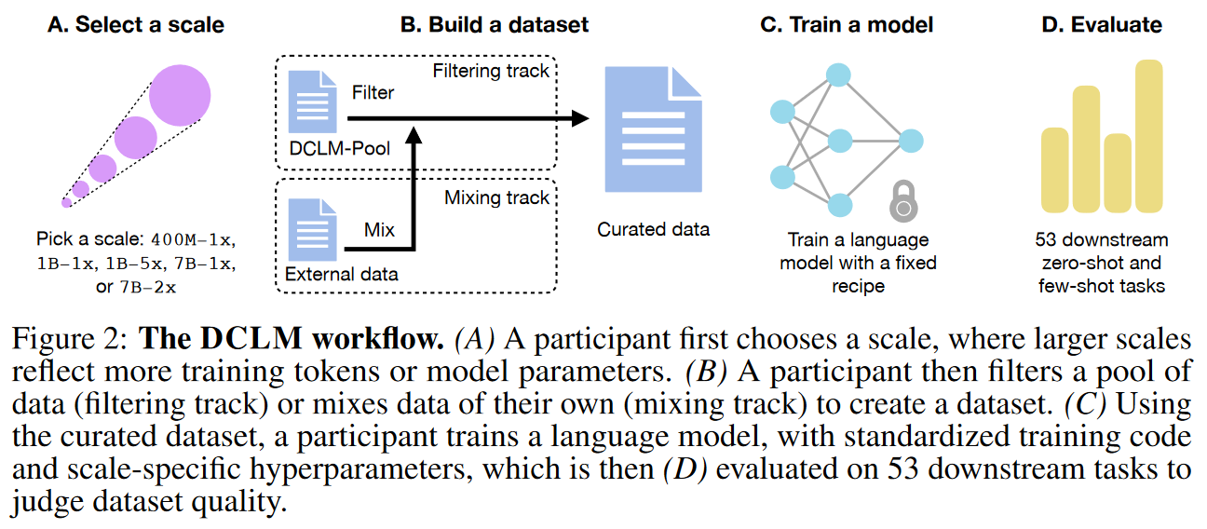
The DCLM workflow
tools provided
240T tokens

Slide 6
Baseline experiments on DCLM
416 baseline experiments (different training sets and compute scales).
Conclusions:
Model-based filtering is a key component.
Details of filtering model can have a large impact on performance.
A bigram classifier with carefully chosen examples is enough.
Human quality judgments have only limited value.
DCLM-baseline: a new SOTA public training set.

Slide 7
The DCLM benchmark - DCLM-Pool
DCLM-Pool: all web-text Common Crawl data prior to 2023.
The text are re-extracted from HTML using resiliparse.
200B documents = 370TB after gzip compression = 240T GPT-NeoX tokens.
Decontamination tools are released.
DCLM-Pool is not decontaminated.
It can allow participants to examine their datasets for overlap with the test sets.
A decontamination report is required for submissions.
Specifically evaluate the highest scoring submissions for decontamination.

Slide 8
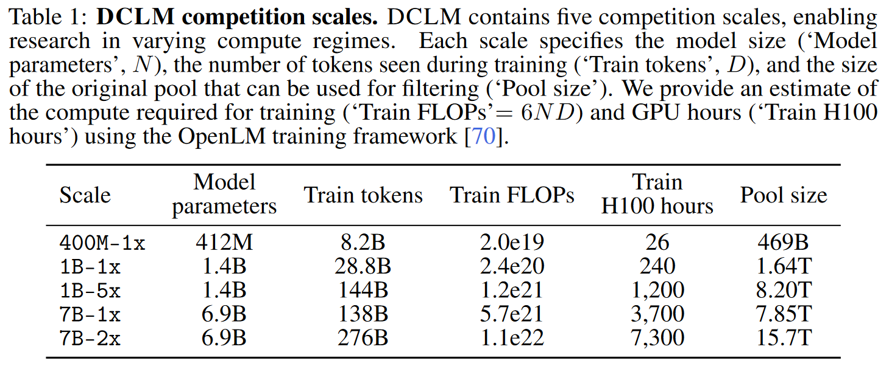
The DCLM benchmark - Scales
Random document subset
=20 × parameters × Nx

Slide 9
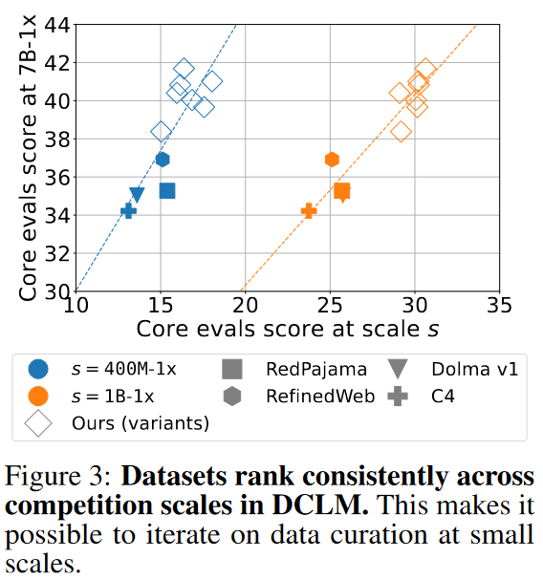
Better curation strategies at smaller scales transfer to larger scales.

Slide 10
The DCLM benchmark
2 tracks: Filtering track & mixing track.
Evaluation data can only be used for evaluation and decontamination.
The training recipe and the evaluation suite are fixed.
Metrics:
MMLU 5-shot accuracy: widely used.
Core centered accuracy: 22 tasks, low-variance, linearly rescaled (0 = random guessing, 1 = perfect accuracy).
Extended centered accuracy: averaged centered performance of all 53 tasks.

Slide 11
Training details
Based on OpenLM.
Decoder-only.
Pre-norm.
qk-LayerNorm.
SwiGLU MLPs.
Depth-scaled initialization.
Sequence length 2048.
Concatenate documents.
EOS token to split documents.
Allow cross-document attention.
GPT-NeoX tokenization.
50k vocabulary.
Z-loss next-token prediction.

Slide 12
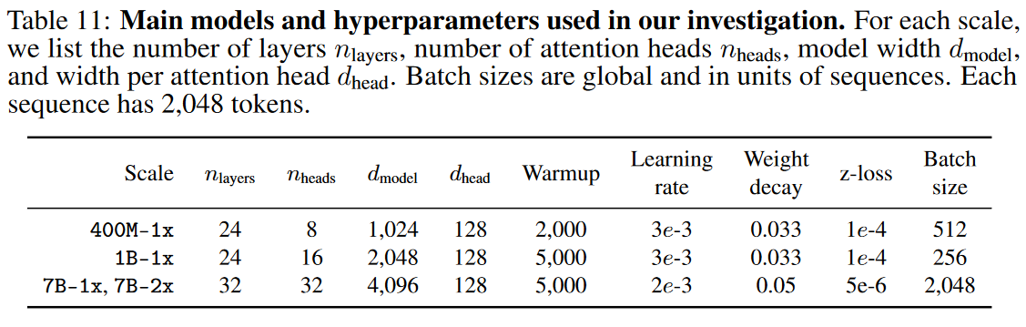
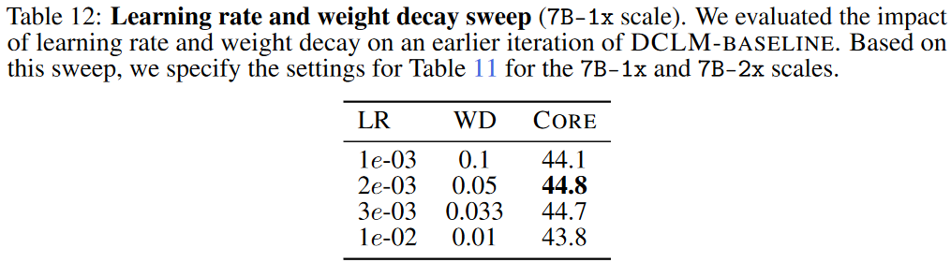
Training hyperparameters

Slide 13
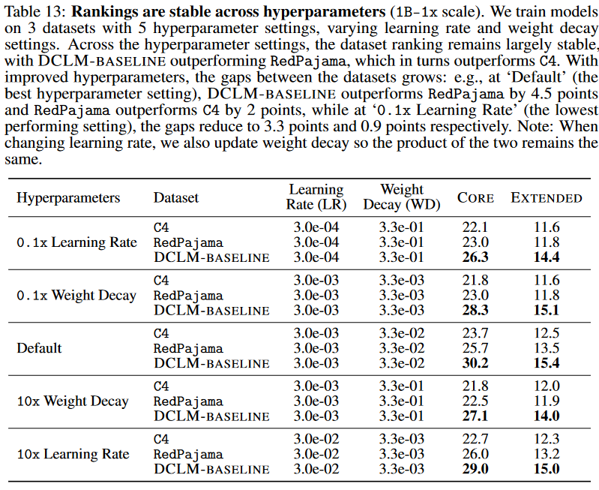
Training hyperparameter ablation

Slide 14
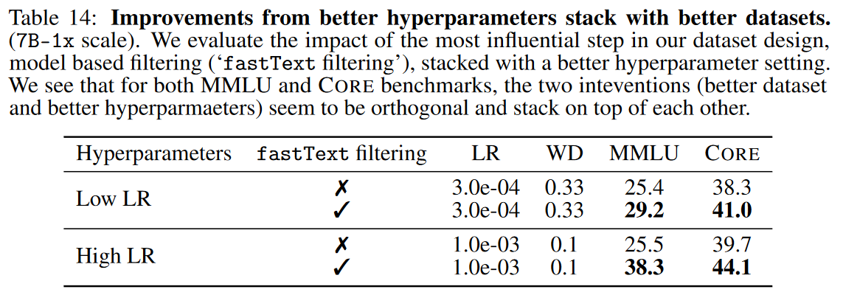
Training hyperparameter ablation

Slide 15
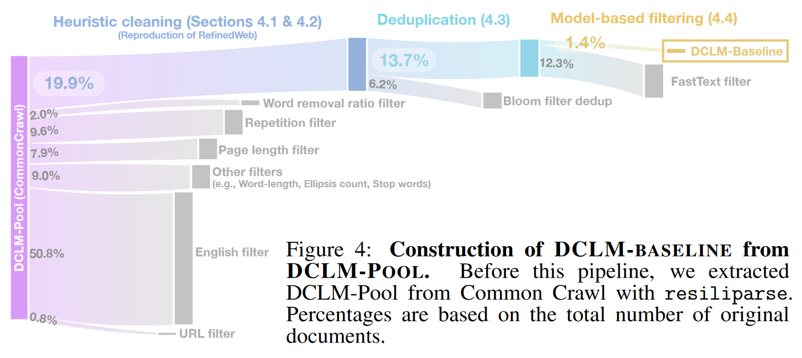
DCLM-baseline

Slide 16
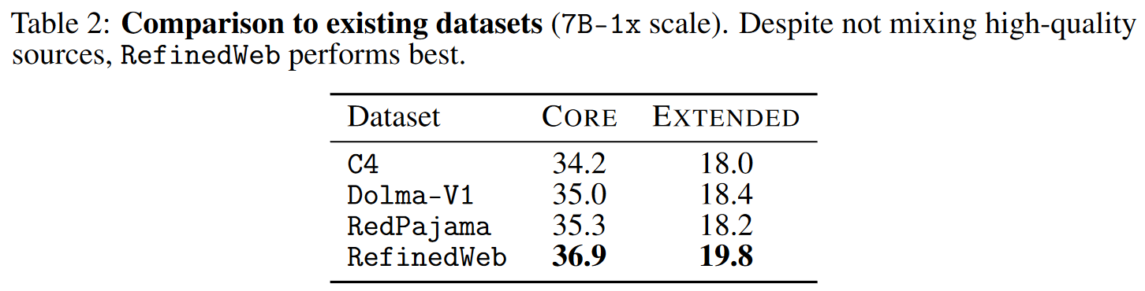
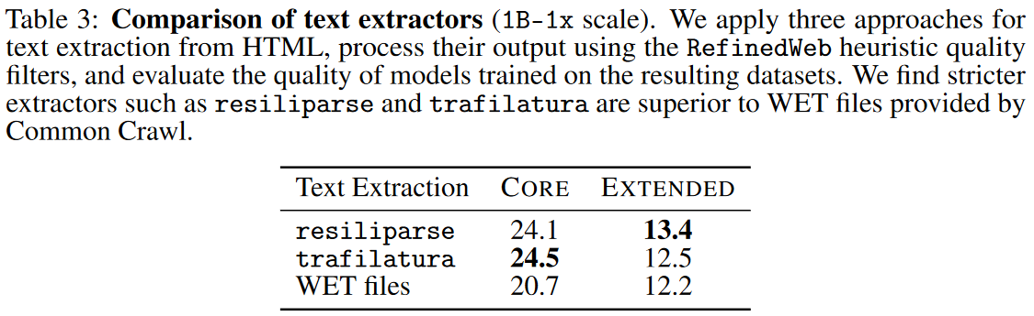
DCLM-baseline - Heuristic cleaning
8-time faster

Slide 17
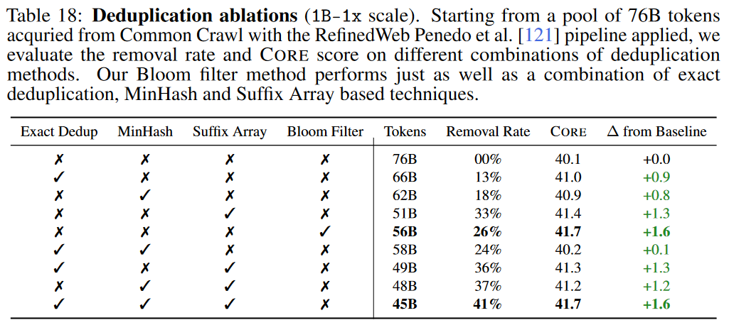
DCLM-baseline - Deduplication
Remove all repeated substring >= 50 tokens
5-gram, 0.8 Jaccard similarity
0.01 false positive rate, 13-gram

Slide 18
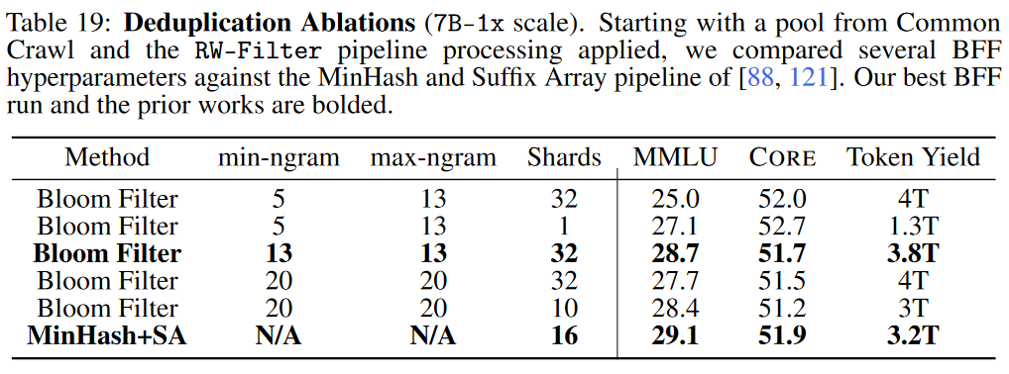
Deduplication Ablation - 7B-1x

Slide 19
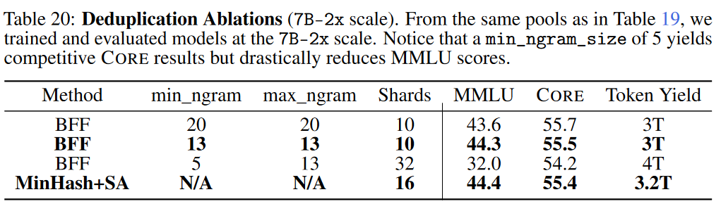
Deduplication Ablation - 7B-2x

Slide 20
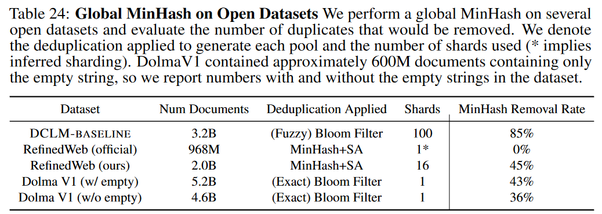
Deduplication result

Slide 21
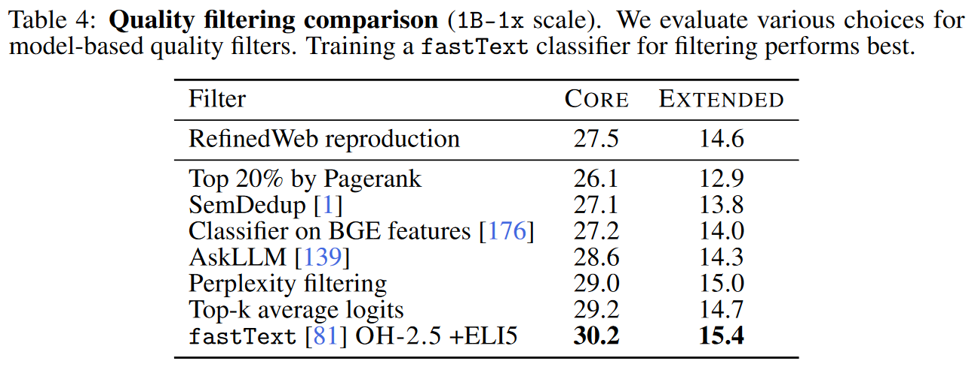
DCLM-baseline - Model-based quality filtering
Classifiers are trained on ~400k documents (200k positive, 200k negative).
Logits are based on an 154M Transformer trained on English wiki + RedPajama-books + peS2o.

Slide 22
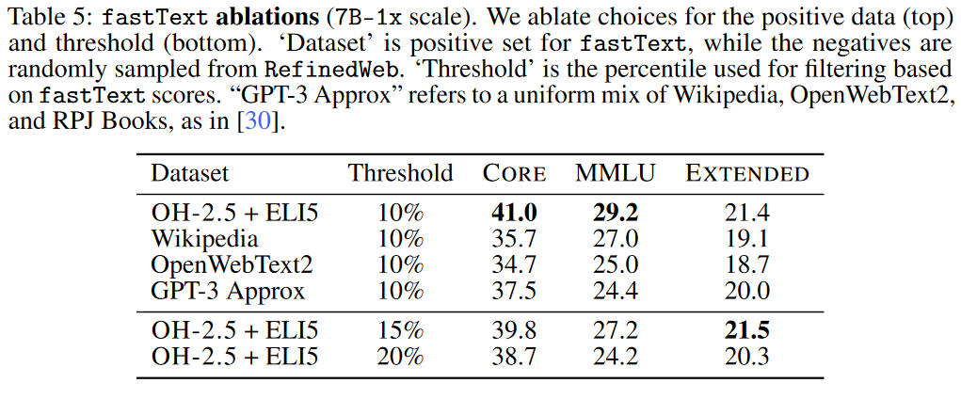
DCLM-baseline - Model-based quality filtering
OH-2.5: OpenHermes 2.5;
ELI5: high-scoring posts from the r/ExplainLikeImFive subreddit.

Slide 23
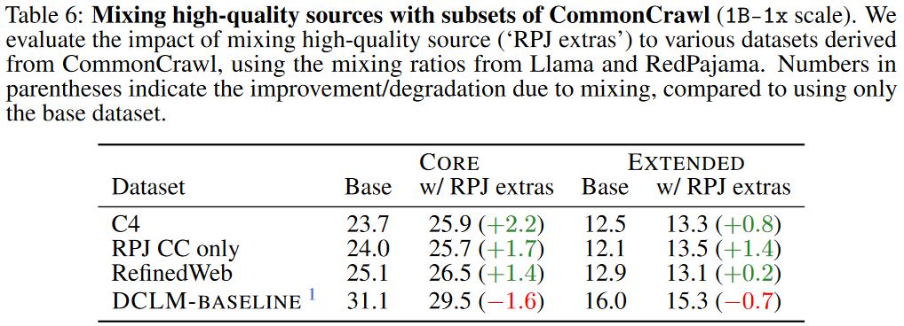
Dataset Mixing

Slide 24
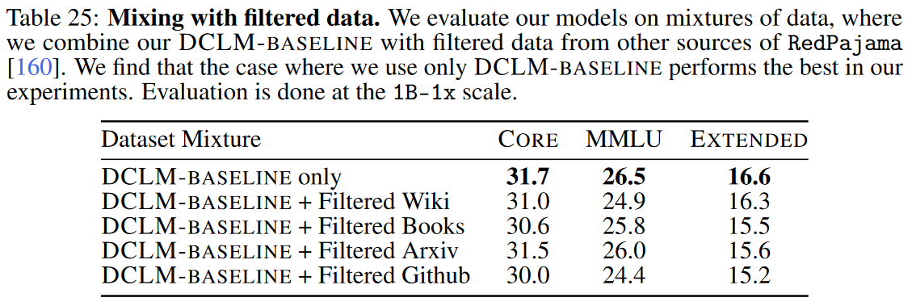
Mixing from different sources

Slide 25
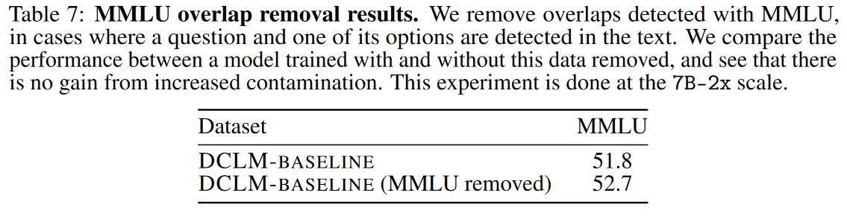
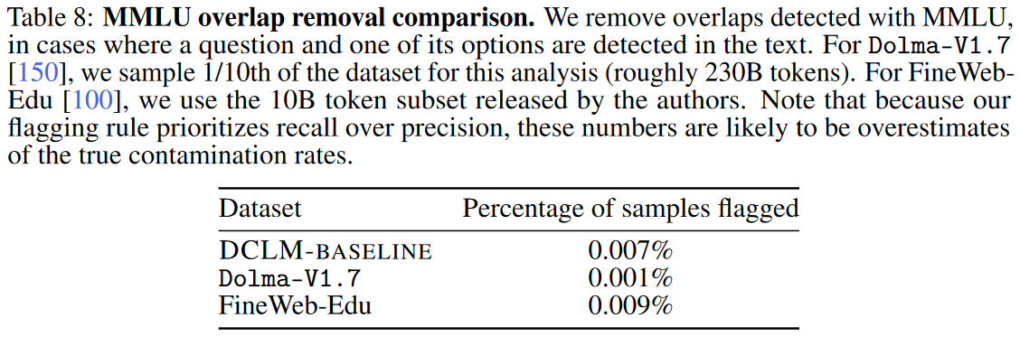
Decontamination

Slide 26
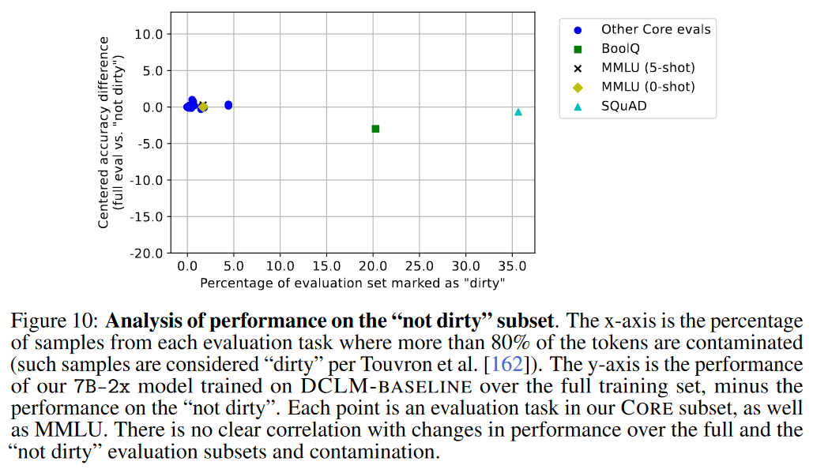
Decontamination

Slide 27
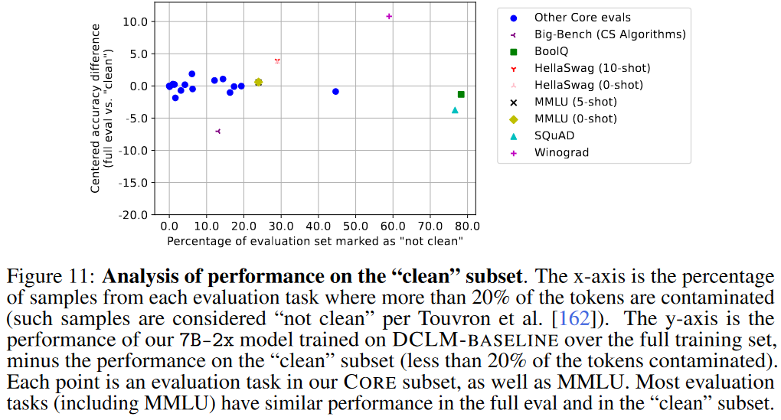
Decontamination

Slide 28
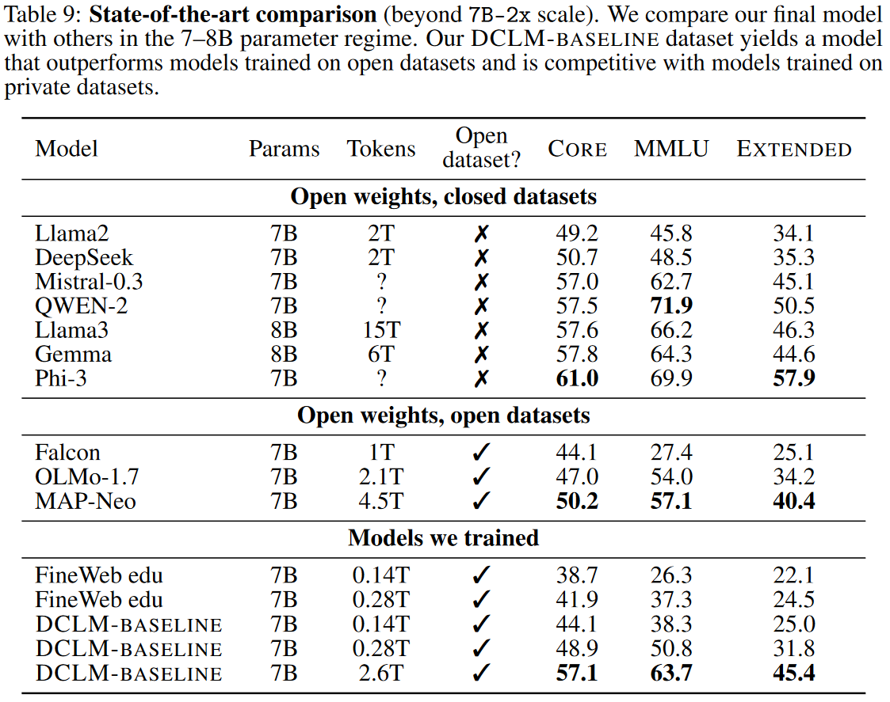
Scaling up DCLM-baseline to trillion tokens
+ StarCoder + ProofPile2

Slide 29
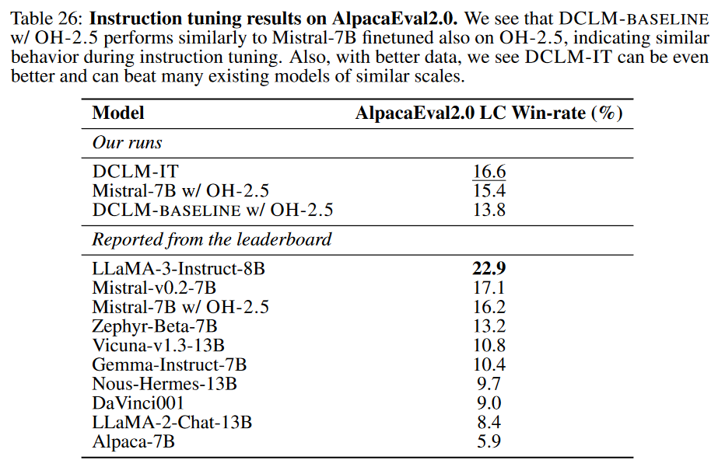
Instruction-tuning result

Slide 30
Ends.

